Slide 1
The floor cleaning robot

Slide 2
Introduction
Floor cleaning robot is a smart phone controlled robot that cleans your house's floor! The rotating mops on the front of the robot along with a foam roller at the back can do the job perfectly. There's also a water pump and water reservoir which can be switched on when required to throw water on the floor and make the mops moist for a proper clean. The foam roller is movable, which means you can lift it when not in use. I've also added speed controls for the driver motors. The project uses Bluetooth communication via an HC-05 Bluetooth module to send the commands to the most commonly used microcontroller- Arduino UNO. The robot is powered on a 12V lead acid battery, the ideal voltage for all motors used here.. The driver motor pair are 100rpm ones while for the mops I've used 75rpm plastic ones. The best part is that the mops used were homemade, from old CDs and rags and they clean just perfectly. Software for programming of “The Floor Cleaning robot” is Arduino IDE. We use C/C++ as programming language.

Slide 3
How to make
Parts and Tools
Get the Base Ready
Make the Floor Mops and Attach Them to the Base
The Water Supply Mechanism
Roller Mechanism
Solder the Circuits
Connections
Upload the Code
Attach the Battery
Configure the App and Connect

Slide 4
PARTS AND TOOLS
2x 100rpm Geared motors
2x Wheels for motors
2x 75rpm Plastic geared motors w/ wheels
1x Arduino UNO
1x HC-05/06 Bluetooth module
1x L293D motor driver board
1x Standard servo motor (180 degree rotation)
1x 12V Sealed lead acid rechargeable battery
1x 12V Water pump
2x TIP31C/TIP122 NPN power transistors
2x Old CDs
A paint roller w/ shaft
Wiping cloth/ napkin/ old rags
A needle and thread
Vinyl tubing
Rainbow wire
Male-male/ female-female/ male-female jumper wires
Male/female headers
Perforated board
Nuts and Screws
Plywood base
Paint roller w/ shaft
A 600ml plastic bottle
Solder, Drill and Glue Gun

Slide 5
GET THE BASE READY
The first step is to prepare the base on which the parts will be placed. For this, first get a piece of plywood cut, measuring 12x9 inches. The base wasn't looking great at all, so to make it look a bit attractive, I painted it in white and orange stripes with black at the borders with acrylic paints.
After this, drill two holes each at the back for both the motor clamps. Make proper measurements such that both should be parallel to each other. Fix them in place using some screws then attach the motors to the clamps.

Slide 6
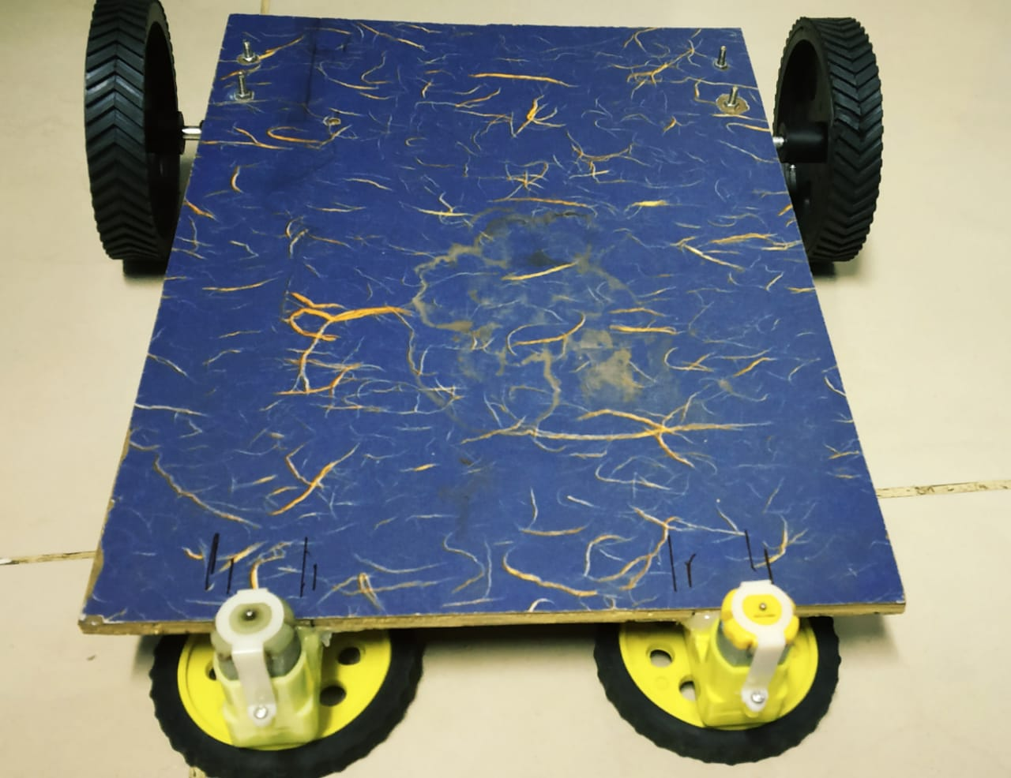
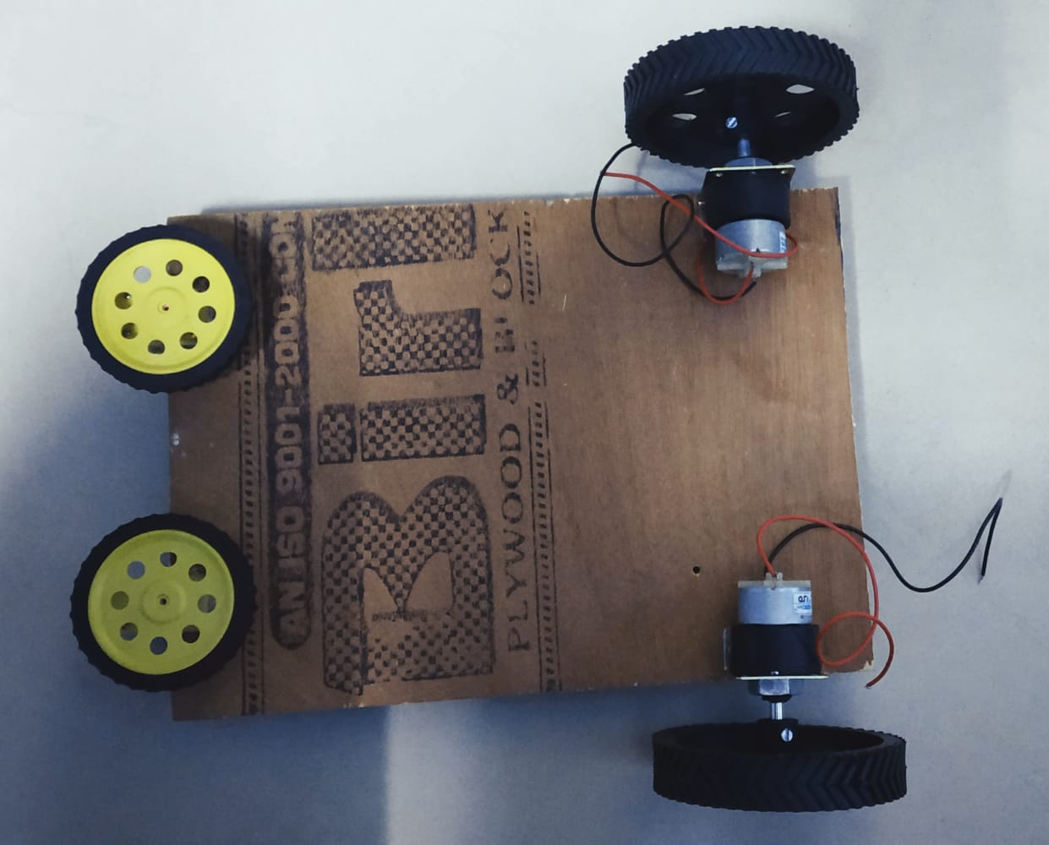

Slide 7
MAKE FLOOR MOPS
First mark a circle on the cloth which should be bigger than the CD. Cut it using a pair of scissors.
Take a needle and thread and start sewing and making folds to the cloth in such a way that it surrounds the entire CD.
Attach wheels to both the plastic geared motors. Hot glue the wheels to the CDs.

Slide 8
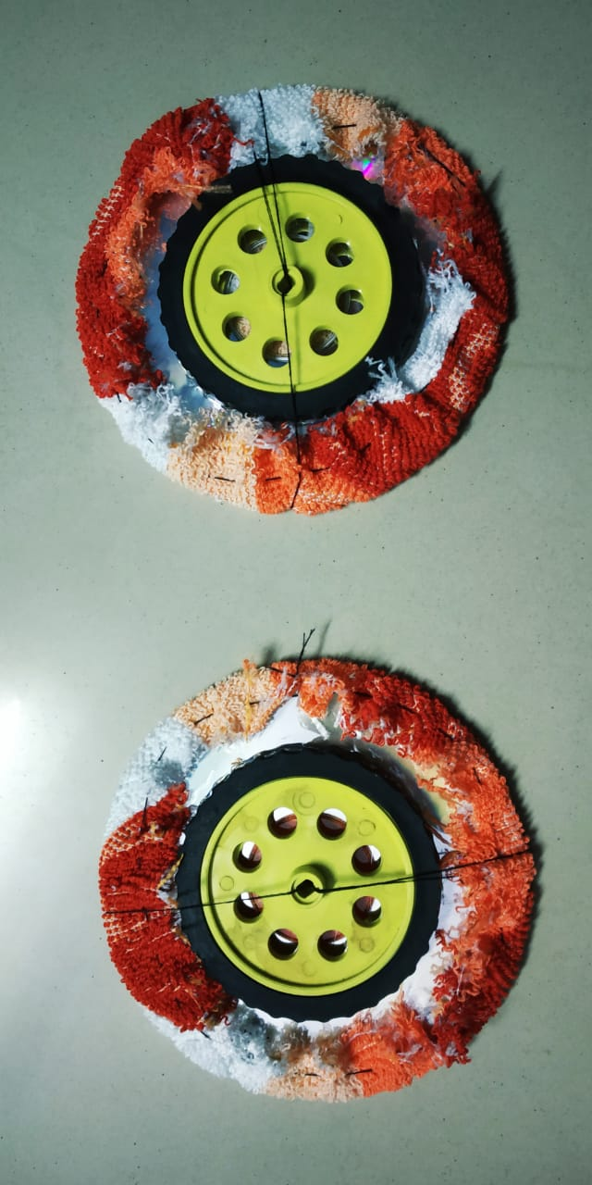
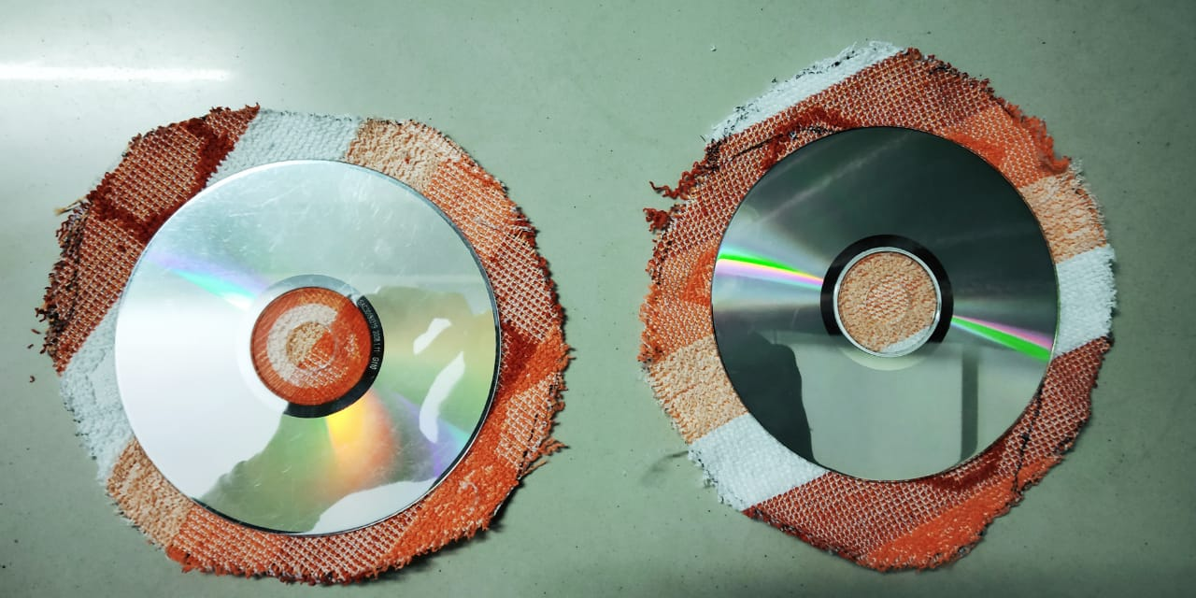

Slide 9
THE WATER SUPPLY MECHANISM
Take a 1ltr empty plastic bottle and cut it into half using a paper cutter. Use the lower half and place it on the robot base using some hot glue.
Take two pieces of rubber tubing. One will be connected to the inlet of pump to take water from the reservoir from the pump and the second one will be used to take water from the pump to the floor. Adding straws to the outlet will be done later.

Slide 10
ROLLER MECHANISM
The purpose of roller here is to stick small dust particles to itself. It will not be needed everytime the robot is moving so I decided to make a simple mechanism which can lift it up or down via a servo motor.
The motor will have to be placed at a height so the roller touches the floor and can be lifted easily. Use two 7x2.5 centimetres wooden pieces and hot glue the servo to their top.

Slide 11
SOLDER THE CIRCUITS
For the mop geared motors and the water pump to be controlled via arduino, there has to be an external circuit as both of them need 12V to run but arduino can only provide a 5V output. I used TIP31C NPN power transistors and soldered them on to a piece of perfboard.
Also, I soldered some male and female headers to make +5V and Gnd power rails as these pins are limited on the arduino and we need plenty of them for each component to be connected.

Slide 12
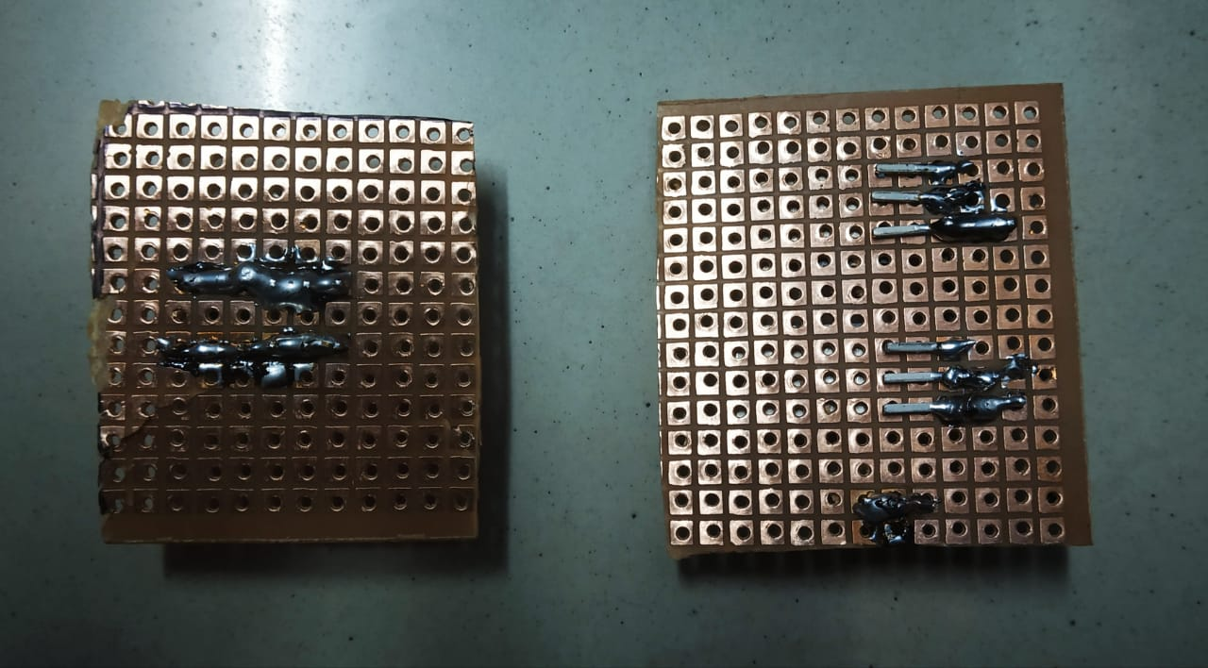
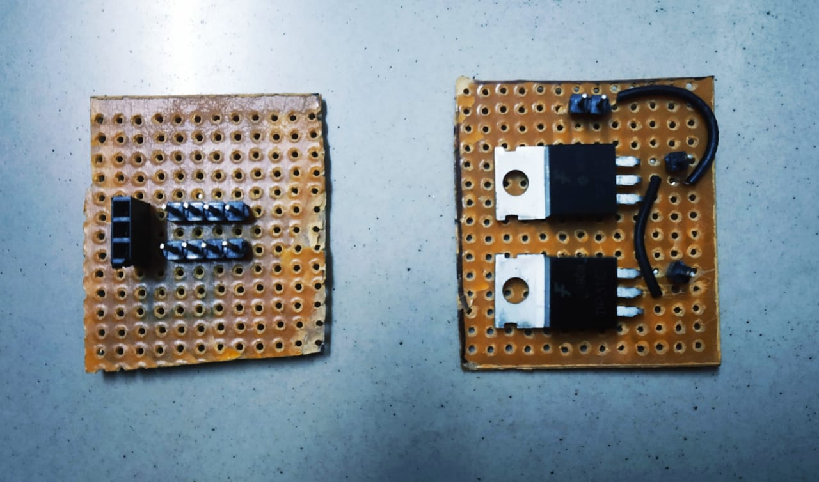

Slide 13
CONNECTIONS
Now this is always the typical part. You have to be accurate. For making it a bit easier, I always use jumper wires which can be swapped or removed any time.
Fix the Arduino, connect the motor driver to it. Motor driver will control the rear tyres. Connect the bluetooth module to Arduino. Then connect the servo motor to the arduino.
Mops are connected in such a way that they rotate in opposite direction to each other. Pump and mops are connected to the transistor circuit. Battery is then connected to the circuit. +ve terminal goes to transistor circuit and –ve is then grounded.

Slide 14
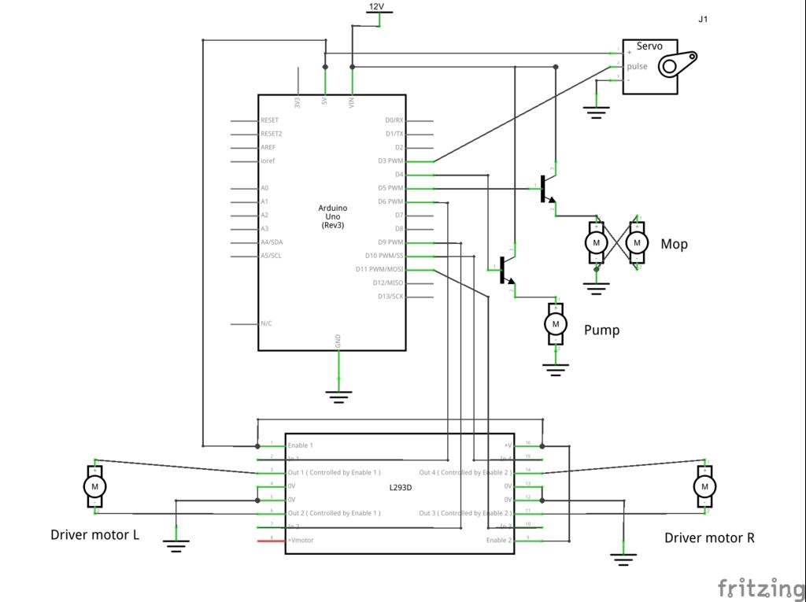

Slide 15
Upload the code
Remove the Rx and Tx cables from arduino before uploading.
Connect the board to a pc and program it with the code.
Make sure you set the correct COM port and Board under Tools.
After it's done, replace the Rx and Tx wires. You'll need to remove them everytime you upload the code.

Slide 16
CONCLUSION
This project is a small model of cleaning machines used in large complex to clean floors. The project is completed and is ready to use. Battery used is chargeable and use of it is economical.

Slide 17
REFERENCES
https://www.instructables.com/id/CleanSweep-the-Floor-Cleaning-Robot/
https://www.youtube.com/watch?v=JlrvP6vElCk
https://www.youtube.com/watch?v=B92vy_2ewfg&t=30s

Slide 18
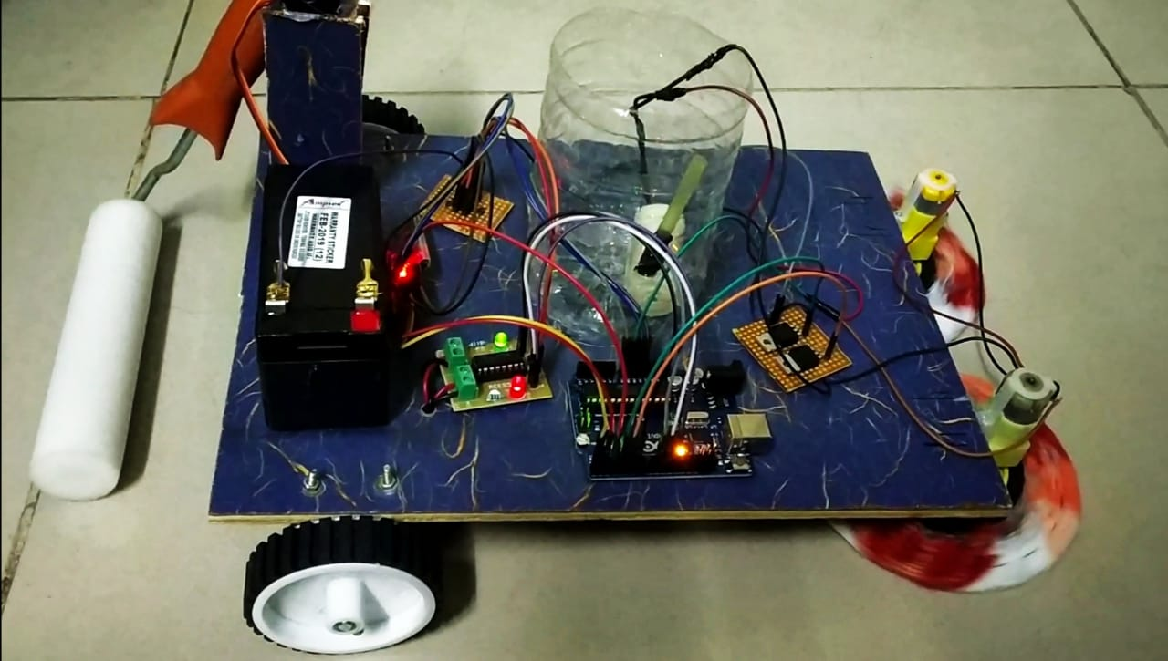

Slide 19
Thank You

